Slide 1
Terrain association
Matching maps to ground and vice versa
Notes:
[From Army Field Manual, FM3-25.26, Map Reading and Land Navigation]
[Do not stress this, but it would provide a response for questions regarding a systematic approach to terrain interpretation/association.]
SOSES:
Shape – general form or outline of the feature at its base
Orientation – general trend or direction of a feature from your viewpoint. A feature can be a line across, or at an angle to your viewpoint.
Size – Then length and width of a feature horizontally across its base. Compare size to other features.
Elevation – The height of a terrain feature (absolute and relative to nearby features)
Slope – Type (uniform, convex, concave) and the steepness or angle of the sides of the feature.

Slide 2
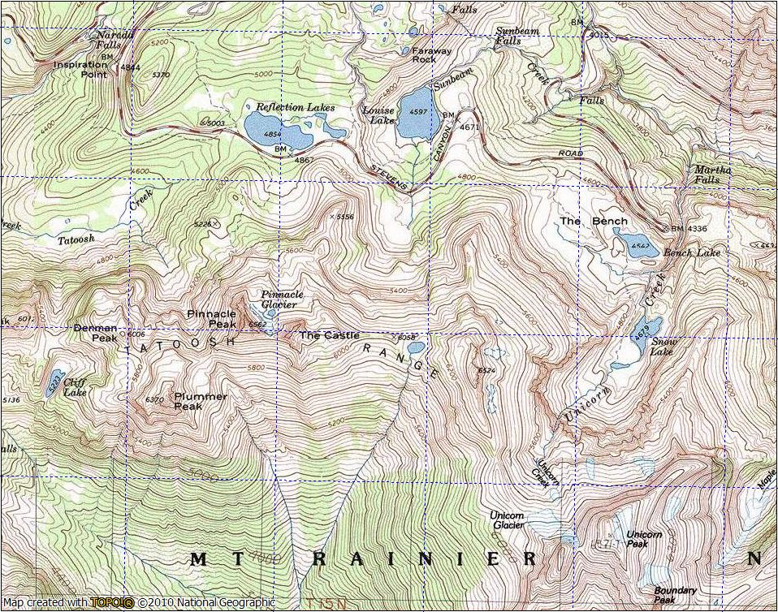
Terrain Association
Notes:
“Terrain features do not normally stand alone. To better understand these when they are depicted on a map you need to interpret them. Terrain features are interpreted using contour lines.” (FM 3-25.26)
A General Procedure in the Field:
Orient the map (Compass or by terrain recognition)
Always watch were you are going with the map, i.e., navigating by terrain association alone “Stay Found”.
Begin matching the terrain you see to what is on the map (landforms, water bodies/streams, cultural features)

Slide 3
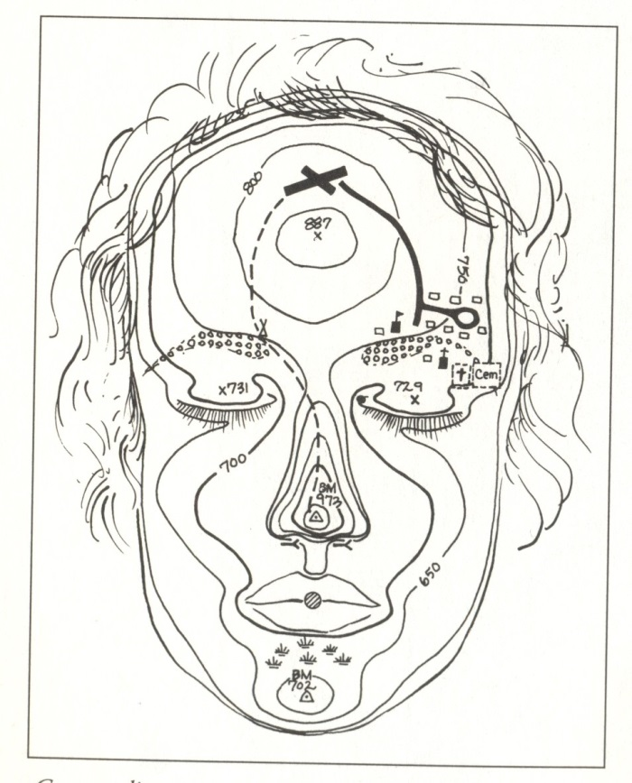
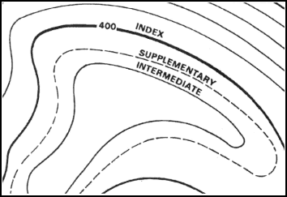
Terrain association: Contours
Ref: FM 3-25.26
Ref: Seidman, 1995
Notes:
Already discussed contours.
The main feature of topographic maps that enables us to interpret landforms.
More detail regarding how to read them and interpret the represented landforms.

Slide 4
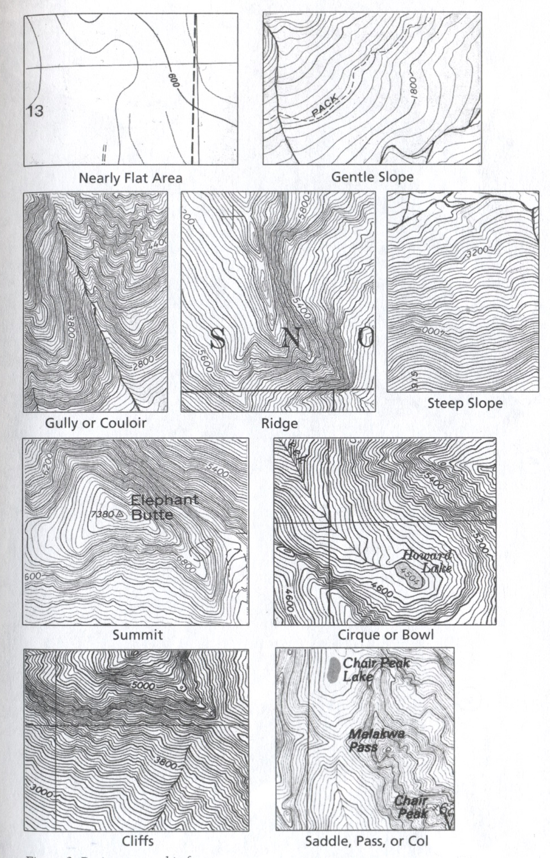
Terrain Assoc.
Basic Landforms
Ref: Burns and Burns, 2004
Notes:
Page 18 in book
Main features shown by contours:
Slope gradient (Flat → Steep)
Cliffs (→ Vertical)
Drainages (Valleys, Gullies, Couloirs)
Ridges
Peaks
Cirques
Saddles, Passes, Cols
Closer ⇒ Steeper slope
Drainages ⇒ V (steep) or U (gentle) shaped contours, V or U points to higher elevation
Ridges ⇒ V (sharp/knife edged) or U (rounded) shaped contours, V or U points to lower elevation
Saddle ⇒ higher contours lines on each side (hourglass shaped)
Peak ⇒ concentric contours; sometimes named, or marked with an X and an elevation

Slide 5
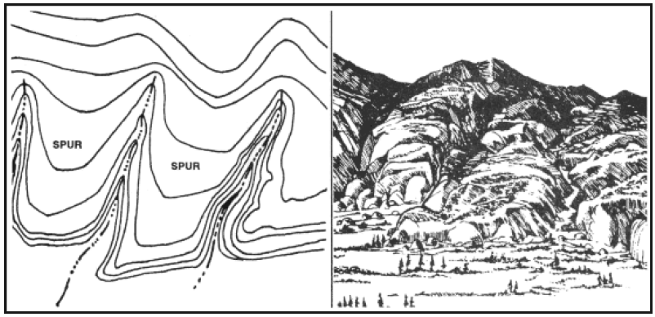
Terrain association: Ridges and Drainages
Ref: FM 3-25.26
Notes:
Another example: steep drainages (and broad/flat side ridges)
Find some steep drainages/couloirs on your map, e.g., Edith Creek west of Stevens Canyon Rd.; Maple Creek above about 4200’; south of Snow Lake (this area is also a cirque or bowl); south of Pt. 5648’ on Stevens Mountain.
Find some ridges on your map, e.g., Plummer, Pinnacle, The Castle, Foss (Pt. 6524); East side of Snow Lake; Alta Vista; Mazama Ridge (very broad)

Slide 6
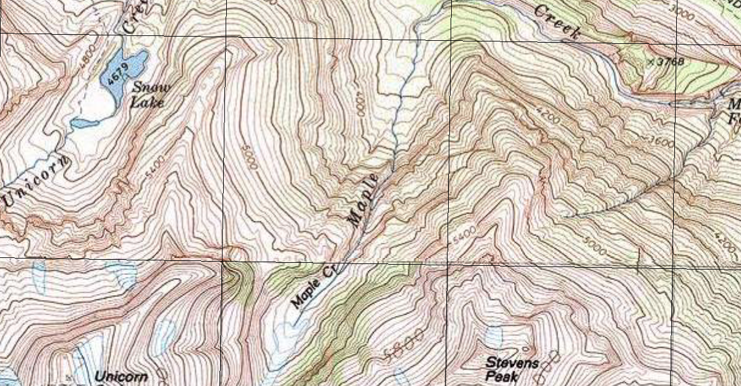
Terrain association: Ridges and Drainages
Drainage
Ridge
Notes:
Usually go up a ridge and/or a gully/couloir to get to the peak.

Slide 7
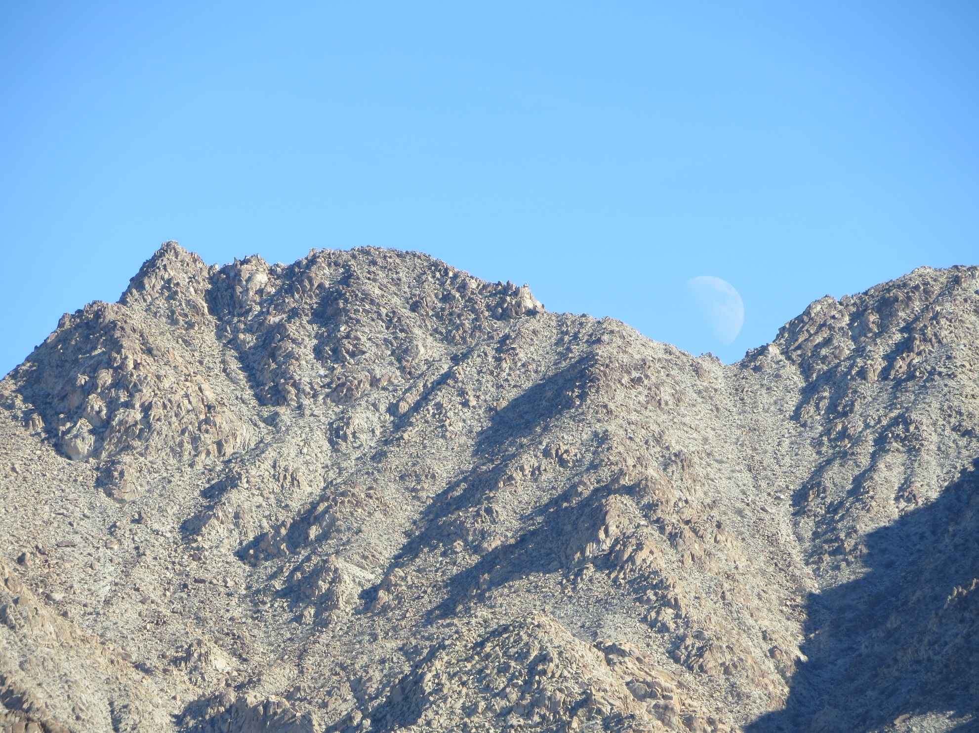
Ridges and Drainages
Ref: FM 3-25.26
Coxcomb Mts., JTNP, CA
Notes:
Another example: steep drainages (and broad/flat side ridges)
Find some steep drainages/couloirs on your map, e.g., Edith Creek west of Stevens Canyon Rd.; Maple Creek above about 4200’; south of Snow Lake (this area is also a cirque or bowl); south of Pt. 5648’ on Stevens Mountain.
Find some ridges on your map, e.g., Plummer, Pinnacle, The Castle, Foss (Pt. 6524); East side of Snow Lake; Alta Vista; Mazama Ridge (very broad)

Slide 8
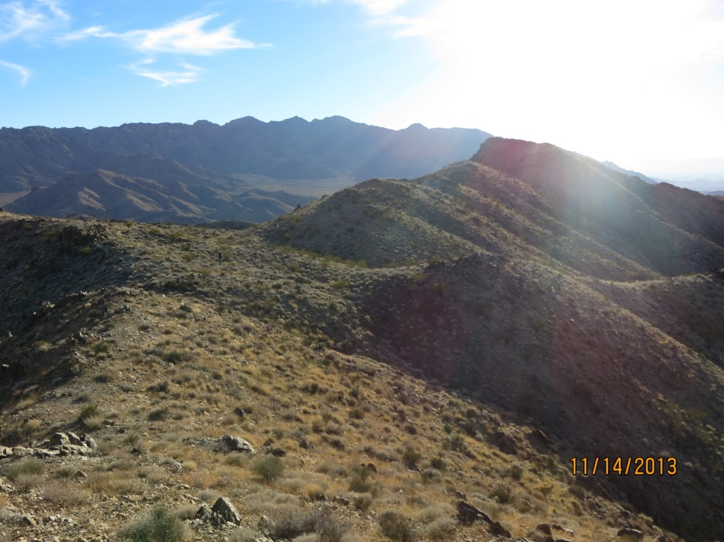
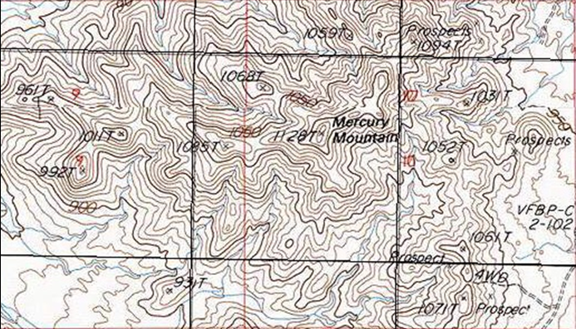
Terrain Association: Ridge
Old Woman Mountains, CA

Slide 9
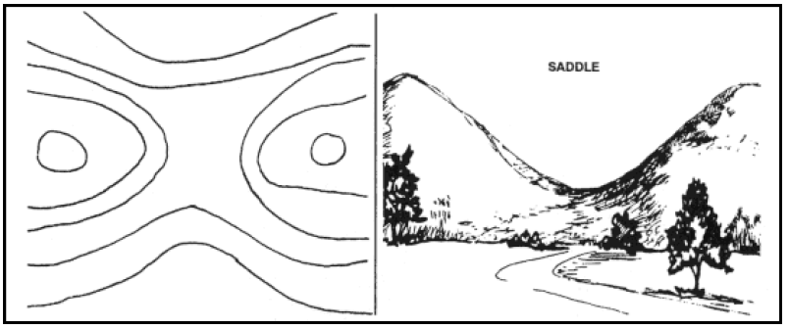
Terrain association: Saddle
Ref: FM 3-25.26

Slide 10
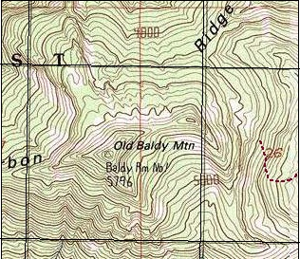
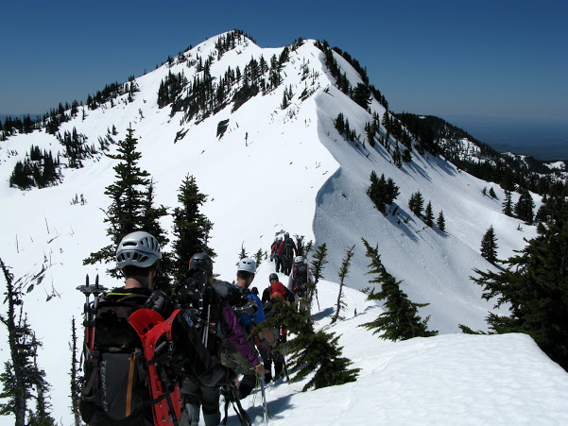
Terrain Association: Saddle
Old Baldy Mountain, WA
Notes:
Find some saddles on your map:
Pinnacle/Plummer saddle
The Castle/Foss (Pt. 6524’)
West of Pt. 5954’ just northwest of Fan Lake

Slide 11
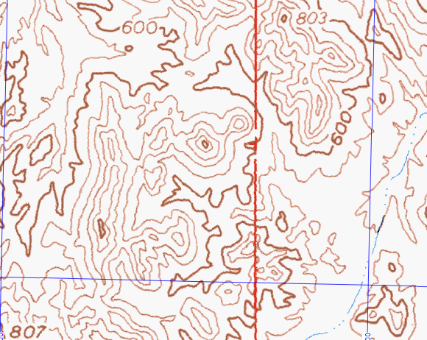
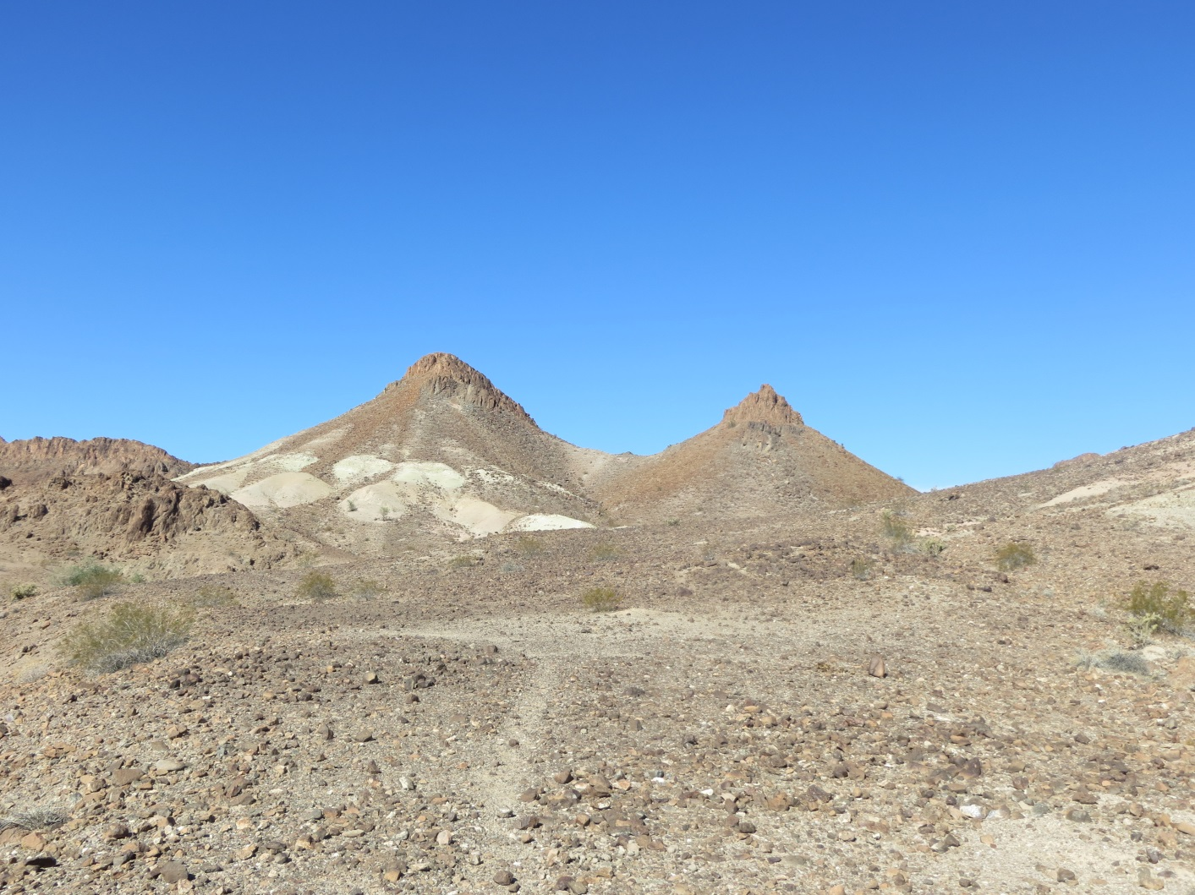
Terrain Association: Saddle
Picacho Pk. Wilderness Area, CA
Notes:
Find some saddles on your map:
Pinnacle/Plummer saddle
The Castle/Foss (Pt. 6524’)
West of Pt. 5954’ just northwest of Fan Lake

Slide 12
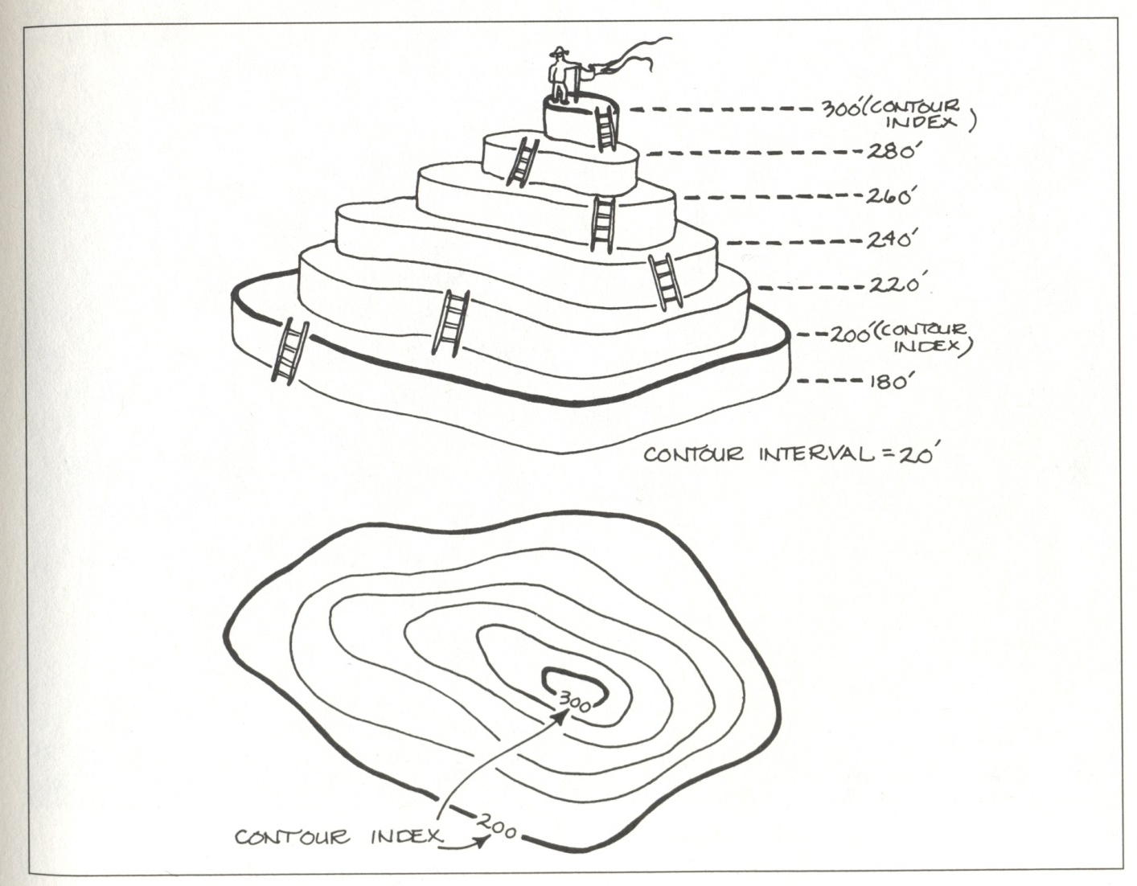
Terrain association: Peak
Ref: Seidman, 1995
Notes:
…and a little more review on contours…

Slide 13
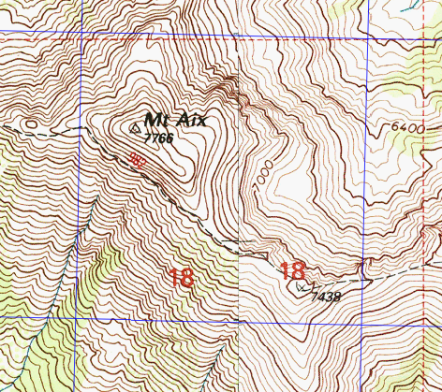
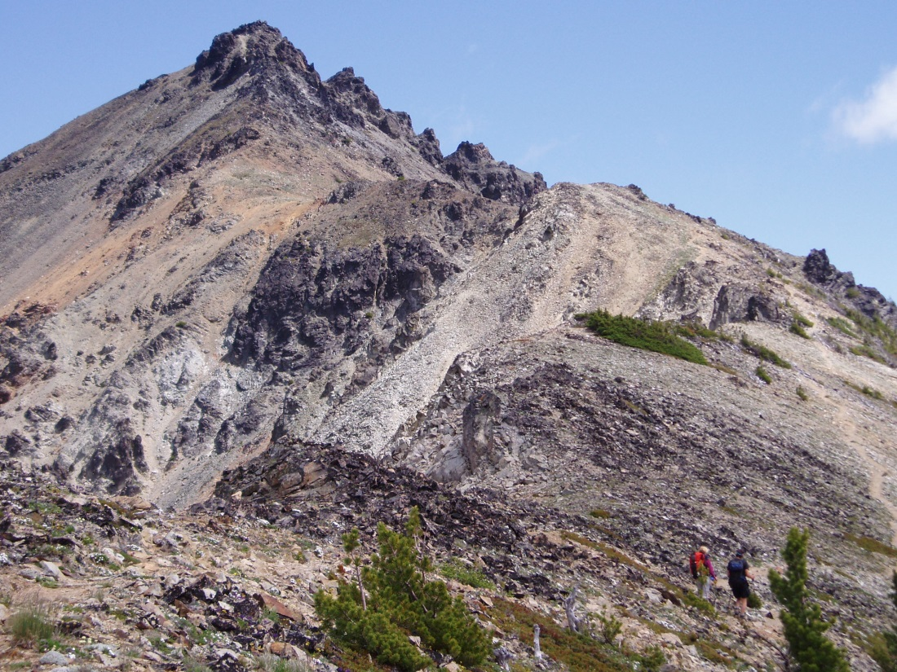
Terrain association: Peak
Mt. Aix
Notes:
Also map has good examples of ridge features, trail and saddles.
No vegetation near top - reflected in white coloring of map
Find some unnamed peaks/high points/summits on your map, e.g., Foss Pk. (Pt. 6524’); Pts. 5648’ and 5561’ on Stevens Ridge; Pt. 5954’ northwest of Fan Lake.

Slide 14
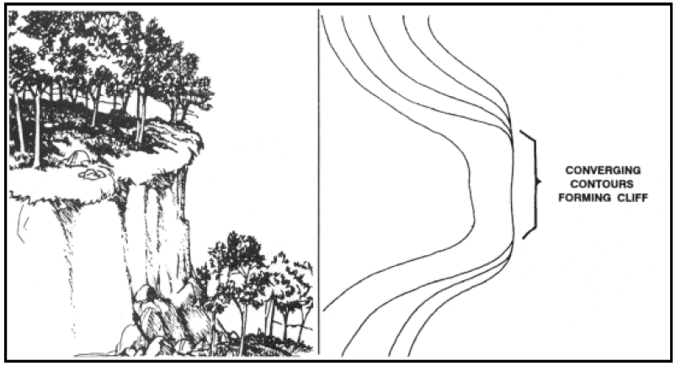
Terrain association: Cliff
FM 3-25.26
Notes:
Avoid for scrambling.
Find some cliffs on your map, e.g., east side Foss Pk (6524’); south of “n” in Unicorn Creek; just south of “Indefinite Boundary”, west side of Pt. 5516’

Slide 15
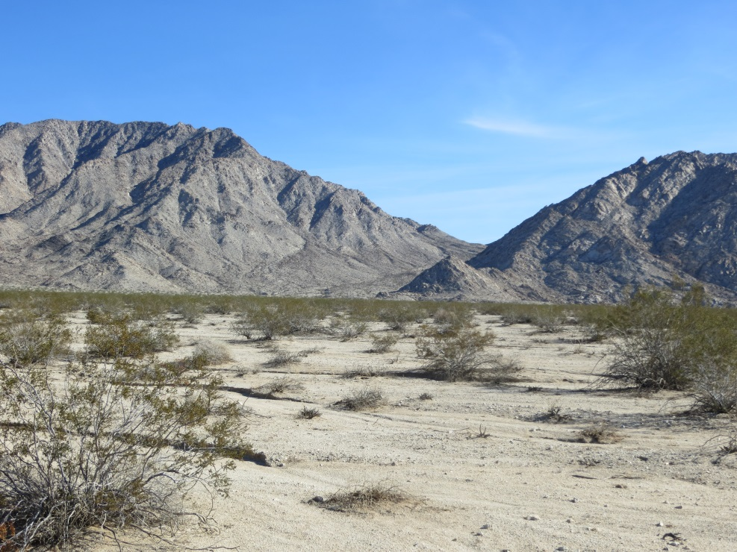
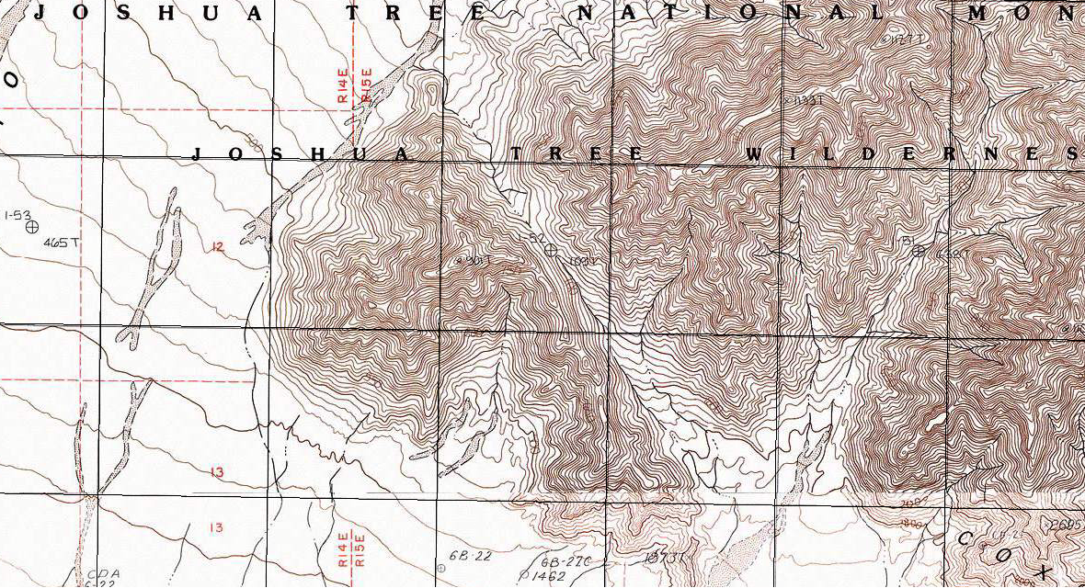
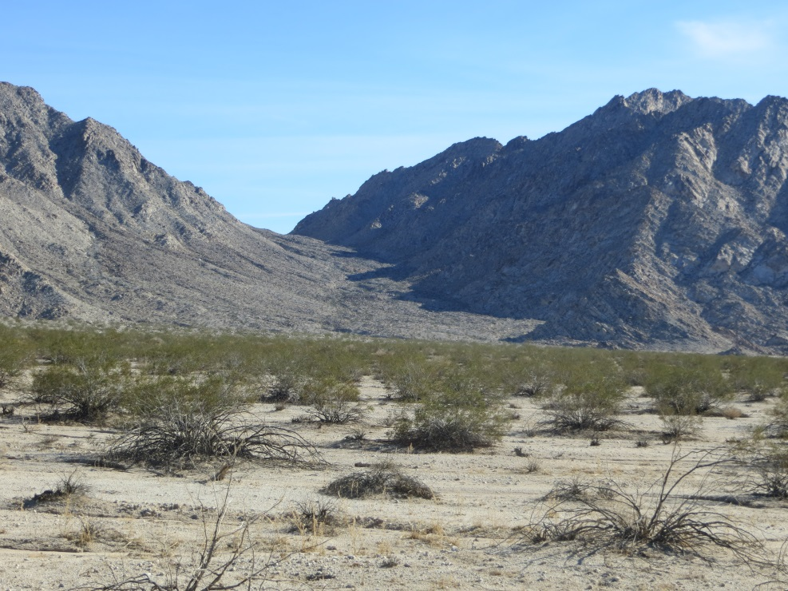
Terrain association
Coxcomb Mountains, CA (JTNP)
Notes:
Kind of putting it all together:
Different view points.
Isolated high point at RHS of drainage harder to see in second view.
Width of valley not as apparent in top view.

Slide 16
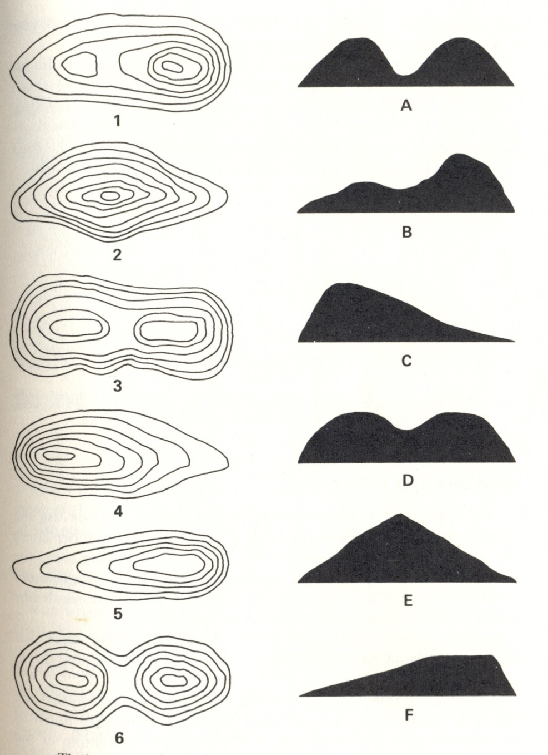
Terrain association: Test Yourself
Ref: Kjellstrom, 1976 (Whoa!)
Notes:
1 = B (saddle; peaks are a different elevations; count contour intervals from base to each peak and compare)
2 = E (peak)
3 = D (saddle; peaks are elongated a same elevation)
4 = C (butte; is also shaped like a drumlin)
5 = F (butte)
6 = A (peaks are same elevation and symmetric)

Slide 17

Terrain association: Test Yourself
1 = B
2 = E
3 = D
4 = C
5 = F
6 = A
Ref: Kjellstrom, 1976 (Whoa!)
Notes:
1 = B (saddle; peaks are a different elevations; count contour intervals from base to each peak and compare)
2 = E (peak)
3 = D (saddle; peaks are elongated a same elevation)
4 = C (butte; is also shaped like a drumlin)
5 = F (butte)
6 = A (peaks are same elevation and symmetric)

Slide 18
Questions?

